Slide 1
Beveridgean Unemployment Gap
By: Pascal Michaillat & Emmanuel Saez 2021
Presented by: Natalie Parker Blount

Slide 2
Contex and Lecture Relation
We have studied the Beveridge Curve and how it can help us determine the unemployment and vacancy tradeoffs.
The Beveridge curve can shift with aggregate demand shocks
This also helps us determine the efficient unemployment rate
We have also learned about transaction costs and the cost of recruiting and the social costs of unemployment
All of these are used in the paper to help determine the answer to the research question
The DMP Model: explains unemployment by looking at how many job seekers there are, how many job vacancies there are, the costs firms incur to fill vacancies, and the costs job seekers incur to find a job

Slide 3
The Research Question
Does the labor market operate efficiently? If not,how far from efficiency is it?
The paper constructs a new measure for the gap between the actual and efficient unemployment rate
This strategy can provide an important piece of statistical information that can be used to guide more effective and efficient public policy
“Two measures of the unemployment gap are commonly used: the difference between the unemployment rate and its trend; and the difference between the unemployment rate and the non-accelerating-inflation rate of unemployment (NAIRU).Although these two measures are easy to use, neither is an ideal measure of the unemployment gap because neither measure the efficient unemployment rate.” (pg 1)

Slide 4
What are the Main Elements to the Answer?
A new measure of the unemployment gap measuring both unemployment and job vacancies
The formula is based on three statistics, characterizes the efficiency point on the Beveridge curve, and works for a variety of other models
The three statistics use in the function are:
  The elasticity of the Beveridge Curve
  Social cost of Unemployment
  Cost of Recruiting
This model always follows the Beveridge Curve as opposed to other models like the Hosios condition

Slide 5
Findings Continued
High social Costs for Unemployment
Efficient unemployment rate in US averages 4.3% and stays between 3.0 and 5.4%
The US labor market is generally inefficient and slack, in times of trouble it is especially slack
The main part of this model is the Beveridge Curve

Slide 6



Equations
Beveridge Curve Elasticity
Social Cost of Unemployment
Recruiting Cost

Slide 7
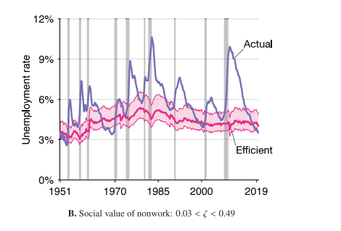
Graphical Representation
This graph shows the findings of the combination of the statistics with an estimated .26 social value of nonwork
Shows the gap between the efficient unemployment rate and the actual unemployment rate

Slide 8
Positioning: How it was impacted by previous literature
Previous literature like , Hagedorn and Manovskii’s, calibration of social value of nonwork was overestimated
In the DMP model (what this essay was tested in), workers’ bargaining power is customarily set at the level given by the Hosios condition (Mortensen and Pissarides, 1994; Shimer, 2005; Costain and Reiter, 2008)
Political theorists indicating a reduction in interest rate lowers unemployment (Bernanke and Blinder, 1992; Coibion, 2012)
Blanchard and Gali (2010, p. 23) find that a monetary-policy rule responding to the unemployment gap and inflation achieves almost the same welfare as the optimal policy. According to that almost-optimal rule, the nominal interest rate should fall when the unemployment gap increases. (Quoted from Pg. 15)

Slide 9
Conclusion
The essay found that the US has a countercyclical unemployment gap and it is not optimal to eliminate the unemployment gap
Unemployment moves along the Beveridge Curve while efficient unemployment rate remains constant
Works for both fixed wages and bargained wages
This model is effective for determining the actual unemployment gap for policy makers
They found that it is optimal to eliminate the unemployment gap by setting the nominal interest rate appropriately (in slumps when the gap is high and to raise it when the economy is booming)
Policy should be adjusted when the labor market is inefficient
This method also works for local labor markets as well as national

